Slide 1
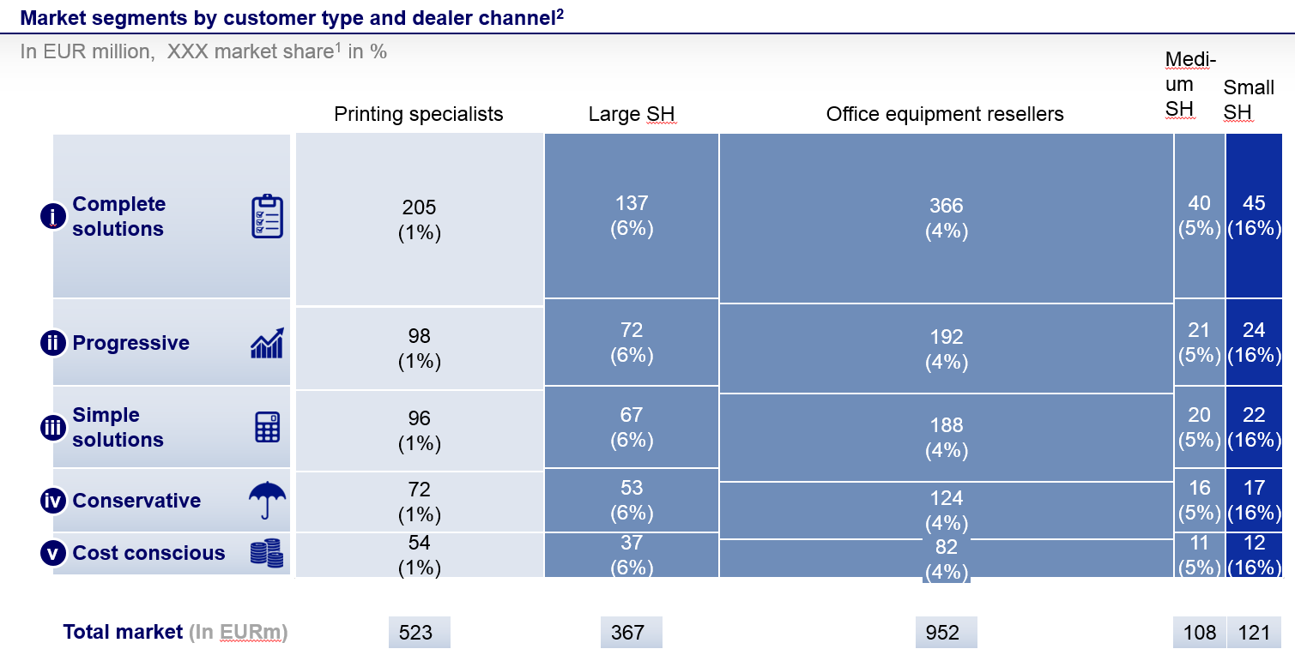
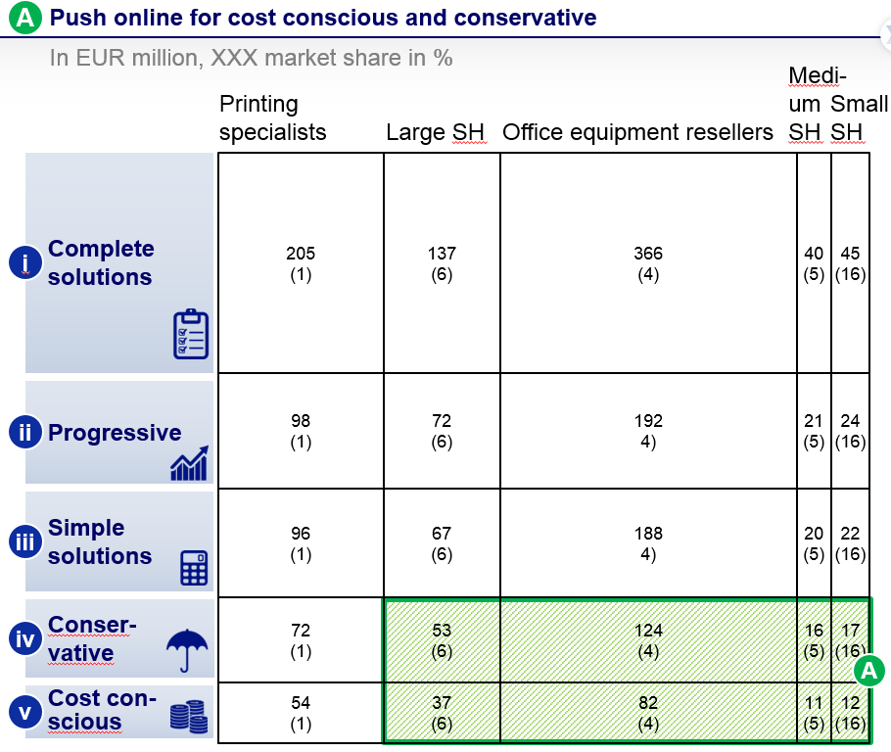
We built a M&S strategy to double an Asian printer manufacturer revenue from targeted segment in 5 years with granular segmentation
Advanced Electronics (AI) | Asia - Pacific
ADE010
Situation
What we did
Estimated impact
An Asian printer manufacturer struggled to expand its revenue from SMB (Small- and Mid- Business) customers
-2% decrease in revenue from SMB focused dealers (-6% for Hardware) in Europe
-4% decrease in # of SMB focused dealers
Communication break down between Asia HQ and European local company
Developed granular market sizing in Europe by the combination of end-user needs-based segmentation and dealer segmentation
Mil Local Currency
Agreed to achieve revenue increase by ~50% in 3 years and ~100% in 5 years with Asia HQ and European local sales company
Built tailored strategies and initiatives for targeted segment areas
2014
18
20
23
Agreed to build new meeting mechanism to capture end-customer and dealer unmet needs in a timely manner

